Slide 1
8.1 General Linear Transformation

Slide 2
Definition
If T: V→W is a function from a vector space V into a vector space W, then T is called a linear transformation from V to W if for all vectors u and v in V and all scalors c
T (u+v) = T (u) + T (v)
T (cu) = cT (u)
In the special case where V=W, the linear transformation T:V→V is called a linear operator on V.

Slide 3
Example 2
Zero Transformation
The mapping T:V→W such that T (v)=0 for every v in V is a linear transformation called the zero transformation. To see that T is linear, observe that
T (u+v) = 0. T (u) = 0, T (v) = 0. And T (k u) = 0
Therefore,
T (u+v) =T (u) +T (v) and T (k u) = kT (u)

Slide 4
Example3
Identify Operator
The mapping I: V→V defined by I (v) = v is called the identify operator on V.

Slide 5
Example 4
Dilation and Contraction operators
Let V be any vector space and k any fixed scalar. The function T:V→V defined by
T (v) = k v
is linear operator on V.
Dilation: k > 1
Contraction: 0 < k < 1

Slide 6
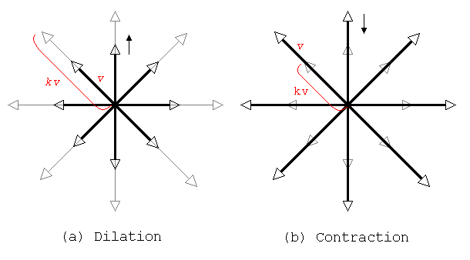
Dilation and Contraction operators

Slide 7
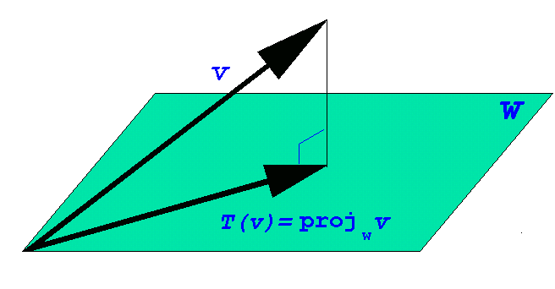
Example 5
Orthogonal Projections
Suppose that W is a finite-dimensional subspace of an inner product space V ; then the orthogonal projection of V onto W is the transformation defined by
T (v ) = projwv

Slide 8
that if
S = {w1, w2, …, wr}
is any orthogonal basis for W, then T (v ) is given by the formula
T (v ) = projwv = <v,w1>w1 + <v,w2>w2 +…+<v,wr>wr
The proof that T is a linear transformation follows from properties of the inner product.
For example,
T (u+v) = <u+v, w1>w1 + <u+v, w2>w2 +… +<u+v, wr> wr
= <u, w1>w1 + <u, w2>w2 +… + <u, wr>wr
+ <v, w1>w1 + <v, w2>w2 +… + <v, wr>wr
= T (u) + T (v)
Simarly, T (ku) = kT (u)

Slide 9
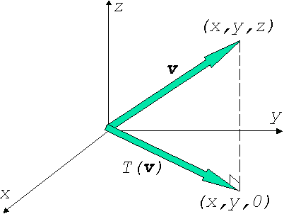
Example 6
Computing an Orthogonal Projection
Let V = R³ have the Euclidean inner product. The vector w₁ = (1,0,0) and w₂ = (0,1,0) from an orthogonal basis for the xy-plane. If v = (x,y,z) is any vector in R³ , the orthogonal projection of R³ onto the xy-plane is given by
T (v ) = <v, w₁>w₁ + <v, w₂>w₂
= x (1, 0, 0) + y (0, 1, 0)
= ( x, y, 0 )

Slide 10
Example 7
A Linear Transformation from a space V to R^{n}
Let S = {w₁ , w₂ , …, w_{n} } be a basis for an n-dimensional vector space V, and let
(v)_{s} = (k_{1,} k_{2,} …, k_{n} )
Be the coordinate vector relative to S of a vector v in V; thus
v = k₁ w + k₂ w₂ + …+ k_{n} w_{n}
Define T: V→R^{n} to be the function that maps v into its coordinate vector relative to S; that is,
T (v) = (v)_{s} = (k_{1,} k_{2,} …, k_{n} )

Slide 11
The function T is linear transformation. To see that this is so, suppose that u and v are vectors in V and that
u = c₁ w₁+ c₂ w₂+ …+ c_{n} w_{n} and
v = d₁ w₁+ d₂ w₂+ …+ d_{n} w_{n}
Thus,
(u)_{s} = (c_{1,} c_{2,} …, c_{n} ) and (v)_{s} = (d_{1,} d_{2,} …, d_{n} )
But
u+v = (c₁+d₁) w₁+ (c₂+d₂) w₂+…+ (c_{n}+d_{n}) w_{n}
k u = (kc₁) w₁ +(kc₂) w₂ +…+ (kc_{n}) w_{n}
So that
(u+v)_{s} = (c₁+d_{1,} c₂+d₂ …, c_{n}+d_{n} )
(k u)_{s} = (kc_{1,} kc_{2,} …, kc_{n} )

Slide 12
Therefore,
(u+v)_{s} = (u)_{s} + (v)_{s} and (k u)_{s} = k (u)_{s}
Expressing these equations of T, we obtain
T (u+v) = T (u) + T (v) and T (k u) = kT (u)
Which shows that T is a linear transformation.
REMARK. The computations in preceding example could just as well have been performed using coordinate matrices rather than coordinate vectors; that is ,
[u+v] = [u]_{s} +[v]_{s} and [k u]_{s} = k [u]_{s}

Slide 13
Example 8
A Linear Transformation from p_{n} to p_{n+1}
Let p = p(x) = C₀ X + C₁X² + …+ C_{n}X ^{n+1} be a polynomial in P_{n} , and define the function T: P_{n} → P_{n+1} by
T (p) = T (p(x)) = xp(x)= C₀ X + C₁X² + …+ C_{n}X ^{n+1}
The function T is a linear transformation, since for any scalar k and any polynomials p₁ and p₂ in P_{n} we have
T (p₁+p₂) = T (p₁(x) + p₂ (x)) = x (p₁(x)+p₂ (x))
= x p₁ (x) + x p₂ (x) = T (p₁) +T (p₂)
and
T (k p) = T (k p(x)) = x (k p(x))= k (x p(x))= k T(p)

Slide 14
Example 9
A linear Operator on P_{n}
Let p = p(x) = c₀ X + c₁X² + …+ c_{n}X ^{n+1} be a polynomial in P_{n} , and let a and b be any scalars. We leave it as an exercise to show that the function T defined by
T (p) = T(p(x)) = p (ax+b) = c₀ + c₁ (ax+b) + …+ c_{n}(ax+b) ^{n}
is a linear operator. For example, if ax+b = 3x – 5, then T: P₂ → P₂ would be the linear operator given by the formula
T (c₀ + c₁x+ c₂ x² ) = c₀ + c₁ (3x-5) + c₂ (3x-5) ²

Slide 15
Example 10
A Linear Transformation Using an Inner Product
Let V be an inner product space and let v₀ be any fixed vector in V. Let T:V→R be the transformation that maps a vector v into its inner product with v₀ ;
that is,
T (v) = <v, v₀>
From the properties of an inner product
T (u+v) = <u+v, v₀>= <u, v₀> + <v, v₀>
and
T (k u) = <k u, v₀ > = k <u, v₀ > = kT (u)
So that T is a linear transformation.

Slide 16
Example 11
A Linear Transformation from C¹(-∞,∞) to F (-∞,∞)
Let V = C¹(-∞,∞) be the vector space of functions with continuous first derivatives on (-∞,∞) and let W = F (-∞,∞) be the vector space of all real-valued functions defined on (-∞,∞).
Let D:V→W be the transformation that maps a function f = f (x) into its derivative; that is,
D (f) = f’ (x)
From the properties of differentiation, we have
D (f+g) = D (f)+D (g) and D (k f) = kD (f)
Thus, D is a linear transformation.

Slide 17
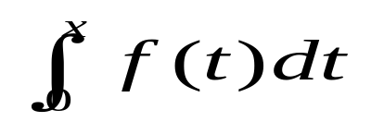


Example 12
A Linear Transformation from C (-∞,∞) to C¹(-∞,∞)
Let V = C (-∞,∞) be the vector space of continuous functions on (-∞,∞) and let W = C¹(-∞,∞) be the vector space of functions with continuous first derivatives on (-∞,∞).
Let J:V→W be the transformation that maps a f = f (x) into the integral . For example, if f=x² , then
J (f) = t²dt =

Slide 18
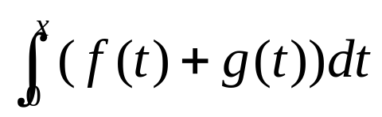

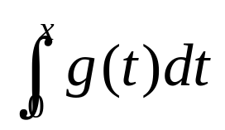
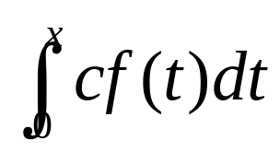
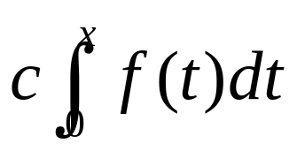
From the properties of integration, we have
J (f+g) = = +
= J (f) + J (g)
J (c f) = = = cJ (f)
So J is a linear transformation.

Slide 19
Example 13
A Transformation That Is Not Linear
Let T:M_{nn} →R be the transformation that maps an n × n matrix into its determinant; that is,
T (A) = det (A)
If n>1, then this transformation does not satisfy either of the properties required of a linear transformation. For example, we saw Example 1 of Section 2.3 that
det (A₁+A₂) ≠ det (A₁) + det (A₂)
in general. Moreover, det (cA) =C ^{n} det (A), so
det (cA) ≠ c det (A)
in general. Thus, T is not linear transformation.

Slide 20
Properties of Linear Transformation
If T:V→W is a linear transformation, then for any vectors v₁ and v₂ in V and any scalars c₁ and c₂ , we have
T (c₁ v₁ + c₂ v₂) = T (c₁ v₁ ) + T (c₂ v₂) = c₁T (v₁ ) + c₂T (v₂)
and more generally, if v₁ , v₂ , …, v_{n} are vectors in V and c₁ , c₂ , …, c_{n} are scalars, then
T (c₁ v₁ + c₂ v₂ +…+ c_{n} v_{n} ) =
c₁T (v₁ ) + c₂T ( v₂ ) +…+ c_{n}T ( v_{n} ) (1)
Formula (1) is sometimes described by saying that linear transformations preserve linear combinations.

Slide 21
Theorem 8.1.1
If T:V→W is a linear transformation, then:
T (0) = 0
T (-v ) = -T (v ) for all v in V
T (v-w ) = T (v ) - T (w) for all v and w in V

Slide 22
Proof.
(a) Let v be any vector in V. Since 0v=0, we have
T (0)=T (0v)=0T (v)=0
(b) T (-v) = T ((-1)v) = (-1)T (v)=-T (v)
(c) v-w=v+(-1)w; thus,
T (v-w)= T (v + (-1)w) = T (v) + (-1)T (w)
= T (v) -T (w)

Slide 23
Finding Linear Transformations from Images of Basis
If T:V→W is a linear transformation, and if {v₁ , v₂ , …, v_{n} } is any basis for V, then the image T (v) of any vector v in V can be calculated from images
T (v₁), T (v₂), …, T (v_{n})
of the basis vectors. This can be done by first expressing v as a linear combination of the basis vectors, say
v = c₁ v₁+ c₂ v₂+ …+ c_{n} v_{n}
and then using Formula(1) to write
T (v) = c₁ T (v₁) + c₂ T (v₂) + … + c_{n} T (v_{n})
In words, a linear transformation is completely determined by its images of any basis vectors.

Slide 24
Example 14
Computing with Images of Basis Vectors
Consider the basis S = {v₁ , v₂ , v₃ } for R³ , where v₁ = (1,1,1), v₂ =(1,1,0), and v₃ = (1,0,0). Let T: R^{3 →}R² be the linear transformation such that
T (v₁)=(1,0), T (v₂)=(2,-1), T (v₃)=(4,3)
Find a formula for T (x₁ , x₂ , x₃ ); then use this formula to compute T (2,-3,5).

Slide 25
Solution.
We first express x = (x₁ , x₂ , x₃ ) as a linear combination of v₁ =(1,1,1), v₂ =(1,1,0), and v₃ = (1,0,0). If we write
(x₁ , x₂ , x₃ ) = c₁ (1,1,1) + c₂ (1,1,0) + c₃ (1,0,0)
then on equating corresponding components we obtain
c₁ + c₂ + c₃ = x₁
c₁ + c₂ = x₂
c₁ = x₃

Slide 26
which yields c₁ = x₃ , c₂ = x₂ - x₃ , c₃ = x₁ - x₂ , so that
(x₁ , x₂ , x₃ ) = x₃ (1,1,1) + (x₂ - x₃ ) (1,1,0) + (x₁ - x₂ ) (1,0,0)
= x₃ v₁ + (x₂ - x₃ ) v₂ + (x₁ - x₂ ) v₃
Thus,
T (x₁ , x₂ , x₃ ) = x₃ T (v₁) + (x₂ - x₃ ) T (v₂) + (x₁ - x₂ ) T (v₃)
= x₃ (1,0) + (x₂ - x₃ ) (2,-1) + (x₁ - x₂ ) (4,3)
= (4x₁ -2x₂ -x₃ , 3x₁ - 4x₂ +x₃)
From this formula we obtain
T (2 , -3 , 5 ) =(9,23)

Slide 27
Composition of T₂ with T₁
If T₁ :U→V and T₂ :V→W are linear transformations, the composition of T₂ with T₁ , denoted by T₂ 。T₁ (read “T₂ circle T₁ ”), is the function defined by the formula
(T₂ 。T₁ )(u) = T₂ (T₁ (u)) (2)
where u is a vector in U

Slide 28
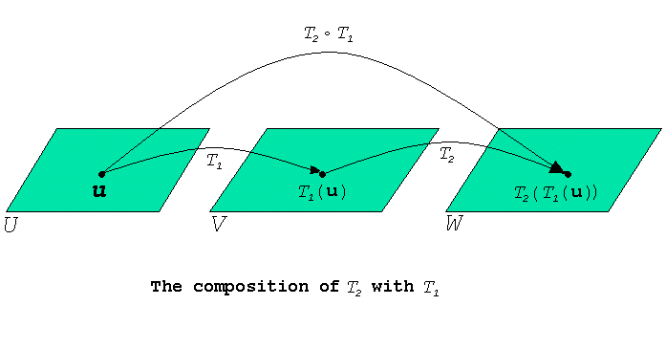

Slide 29
Theorem 8.1.2
If T₁ :U→V and T₂ :V→W are linear transformations, then (T₂ 。T₁ ):U→W is also a linear transformation.

Slide 30
Proof. If u and v are vectors in U and c is a scalar, then it follows from (2) and the linearity of T₁ andT₂ that
(T₂ 。T₁ )(u+v) = T₂ (T₁(u+v)) = T₂ (T₁(u)+T₁ (v))
= T₂ (T₁(u)) + T₂ (T₁(v))
= (T₂ 。T₁ )(u) + (T₂ 。T₁ )(v)
and
(T₂ 。T₁ )(c u) = T₂ (T₁ (c u)) = T₂ (cT₁(u))
= cT₂ (T₁ (u)) = c (T₂ 。T₁ )(u)
Thus, T₂ 。T₁ satisfies the two requirements of a linear transformation.

Slide 31
Example 15
Composition of Linear Transformations
Let T₁ : P₁ → P₁ and T₂ : P₂ → P₂ be the linear transformations given by the formulas
T₁(p(x)) = xp(x) and T₂ (p(x)) = p (2x+4)
Then the composition is (T₂ 。T₁ ): P₁ → P₂ is given by the formula
(T₂ 。T₁ )(p(x)) = (T₂)(T₁(p(x))) = T₂ (xp(x)) = (2x+4)p (2x+4)
In particular, if p(x) = c₀ + c₁ x, then
(T₂ 。T₁ )(p(x)) = (T₂ 。T₁ )(c₀ + c₁ x)
= (2x+4) (c₀ + c₁ (2x+4))
= c₀ (2x+4) + c₁ (2x+4)²

Slide 32
Example 16
Composition with the Identify Operator
If T:V→V is any linear operator, and if I:V→V is the identity operator, then for all vectors v in V we have
(T。I )(v) = T (I (v)) = T (v)
(I。T )(v) = I (T (v)) = T (v)
It follows that T。I and I。T are the same as T ; that is,
T。I=T and I。T = T (3)
We conclude this section by noting that compositions can be defined for more than two linear transformations. For example, if
T₁ : U → V and T₂ : V→ W ,and T₃ : W→ Y

Slide 33
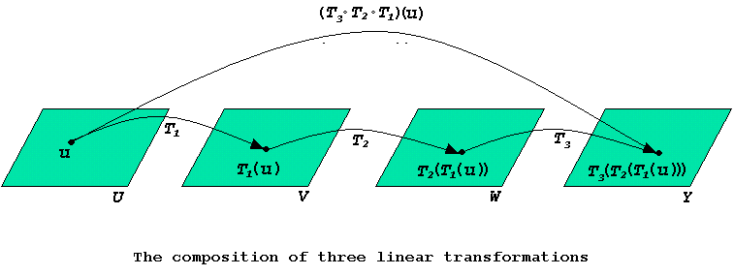
are linear transformations, then the composition T₃。T₂。T₁ is defined by
(T₃。T₂。T₁ )(u) = T₃ (T₂ (T₁ (u))) (4)

Slide 34
8.2 Kernel And Range

Slide 35
Definition
ker(T ): the kernel of T
If T:V→W is a linear transformation, then the set of vectors in V that T maps into 0
R (T ): the range of T
The set of all vectors in W that are images under T of at least one vector in V

Slide 36
Example 1
Kernel and Range of a Matrix Transformation
If T_{A} :R^{n} →R^{m} is multiplication by the m×n matrix A, then from the discussion preceding the definition above,
the kernel of T_{A} is the nullspace of A
the range of T_{A} is the column space of A

Slide 37
Example 2
Kernel and Range of the Zero Transformation
Let T:V→W be the zero transformation. Since T maps every vector in V into 0, it follows that ker(T ) = V.
Moreover, since 0 is the only image under T of vectors in V, we have R (T ) = {0}.

Slide 38
Example 3
Kernel and Range of the Identity Operator
Let I:V→V be the identity operator. Since I (v) = v for all vectors in V, every vector in V is the image of some vector; thus, R(I ) = V.
Since the only vector that I maps into 0 is 0, it follows that ker(I ) = {0}.

Slide 39
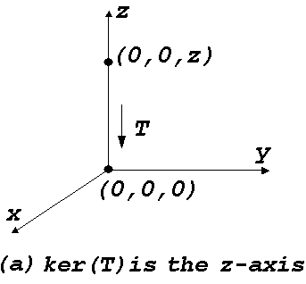
Example 4
Kernel and Range of an Orthogonal Projection
Let T: R³ →R³ be the orthogonal projection on the xy-plane. The kernel of T is the set of points that T maps into 0 = (0,0,0); these are the points on the z-axis.

Slide 40
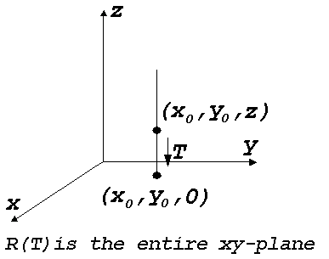
Since T maps every points in R³ into the xy-plane, the range of T must be some subset of this plane. But every point (x₀ ,y₀ ,0) in the xy-plane is the image under T of some point; in fact, it is the image of all points on the vertical line that passes through (x₀ ,y₀ , 0). Thus R(T ) is the entire xy-plane.

Slide 41
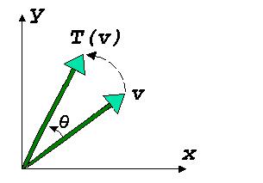
Example 5
Kernel and Range of a Rotation
Let T: R² →R² be the linear operator that rotates each vector in the xy-plane through the angle θ. Since every vector in the xy-plane can be obtained by rotating through some vector through angle θ, we have R(T ) = R² . Moreover, the only vector that rotates into 0 is 0, so ker(T ) = {0}.

Slide 42
Example 6
Kernel of a Differentiation Transformation
Let V= C¹ (-∞,∞) be the vector space of functions with continuous first derivatives on (-∞,∞) , let W = F (-∞,∞) be the vector space of all real-valued functions defined on (-∞,∞) , and let D:V→W be the differentiation transformation D (f) = f’(x).
The kernel of D is the set of functions in V with derivative zero. From calculus, this is the set of constant functions on (-∞,∞) .

Slide 43
Theorem 8.2.1
If T:V→W is linear transformation, then:
The kernel of T is a subspace of V.
The range of T is a subspace of W.

Slide 44
Proof (a).
Let v₁ and v₂ be vectors in ker(T ), and let k be any scalar. Then
T (v₁ + v₂) = T (v₁) + T (v₂) = 0+0 = 0
so that v₁ + v₂ is in ker(T ).
Also,
T (k v₁) = kT (v₁) = k 0 = 0
so that k v₁ is in ker(T ).

Slide 45
Proof (b).
Let w₁ and w₂ be vectors in the range of T , and let k be any scalar. There are vectors a₁ and a₂ in V such that T (a₁) = w₁ and T(a₂) = w₂ . Let a = a₁ + a₂ and b = k a₁ .
Then
T (a) = T (a₁ + a₂) = T (a₁) + T (a₂) = w₁ + w₂
and
T (b) = T (k a₁) = kT (a₁) = k w₁

Slide 46
Definition
nank (T): the rank of T
If T:V→W is a linear transformation, then the dimension of tha range of T is the rank of T .
nullity (T): the nullity of T
the dimension of the kernel is the nullity of T.

Slide 47
Theorem 8.2.2
If A is an m×n matrix and T_{A} :R^{n} →R^{m} is multiplication by A , then:
nullity (T_{A} ) = nullity (A )
rank (T_{A} ) = rank (A )

Slide 48
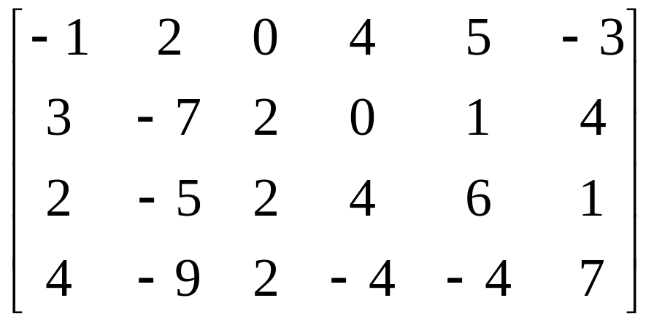
Example 7
Finding Rank and Nullity
Let T_{A} :R⁶ →R⁴ be multiplication by
A=
Find the rank and nullity of T_{A}

Slide 49
Solution.
In Example 1 of Section 5.6 we showed that rank (A ) = 2 and nullity (A ) = 4. Thus, from Theorem 8.2.2 we have rank (T_{A} ) = 2 and nullity (T_{A} ) = 4.

Slide 50
Example 8
Finding Rank and Nullity
Let T: R³ →R³ be the orthogonal projection on the xy-plane. From Example 4, the kernel of T is the z-axis, which is one-dimensional; and the range of T is the xy-plane, which is two-dimensional. Thus,
nullity (T ) = 1 and rank (T ) = 2

Slide 51
Dimension Theorem for Linear Transformations
Theorem 8.2.3
If T:V→W is a linear transformation from an n-dimensional vector space V to a vector space W, then
rank (T ) + nullity (T ) = n
In words, this theorem states that for linear transformations the rank plus the nullity is equal to the dimension of the domain.

Slide 52
Example 9
Using the Dimension Theorem
Let T: R² →R² be the linear operator that rotates each vector in the xy-plane through an angle θ . We showed in Example 5 that ker(T ) = {0} and R (T ) = R² .Thus,
rank (T ) + nullity (T ) = 2 + 0 = 2
Which is consistent with the fact thar the domain of T is two-dimensional.

Slide 53
8.3 Inverse Linear Transformations

Slide 54
Definition
one-to-one
A linear transformation T:V→W is said to be one-to-one if T maps distinct vectors in V into distinct vectors in W .

Slide 55
Example 1
A One-to-One Linear Transformation
Recall from Theorem 4.3.1 that if A is an n×n matrix and T_{A} :R^{n}→R^{n} is multiplication by A , then T_{A} is one-to-one if and only if A is an invertible matrix.

Slide 56
Example 2
A One-to-One Linear Transformation
Let T: P_{n} → P_{n+1} be the linear transformation
T (p) = T(p(x)) = xp(x)
Discussed in Example 8 of Section 8.1. If
p = p(x) = c₀ + c₁ x +…+ c_{n} x^{n} and
q = q(x) = d₀ + d₁ x +…+ d_{n} x^{n}
are distinct polynomials, then they differ in at least one coefficient. Thus,
T(p) = c₀ x + c₁ x² +…+ c_{n} x^{n+1} and
T(q) = d₀ x + d₁ x² +…+ d_{n} x^{n+1}
Also differ in at least one coefficient. Thus, since it maps distinct polynomials p and q into distinct polynomials T (p) and T (q).

Slide 57
Example 3
A Transformation That Is Not One-to-One
Let
D: C¹(-∞,∞) → F (-∞,∞)
be the differentiation transformation discussed in Example 11 of Section 8.1. This linear transformation is not one-to-one because it maps functions that differ by a constant into the same function. For example,
D(x²) = D(x^{n} +1) = 2x

Slide 58
Equivalent Statements
Theorem 8.3.1
If T:V→W is a linear transformation, then the following are equivalent.
T is one-to-one
The kernel of T contains only zero vector; that is , ker(T) = {0}
Nullity (T) = 0

Slide 59
Theorem 8.3.2
If V is a finite-dimensional vector space and
T:V ->V is a linear operator then the following
are equivalent.
(a)T is one to one
(b) ker(T) = {0}
(c)nullity(T) = 0
(d)The range of T is V;that is ,R(T) =V

Slide 60
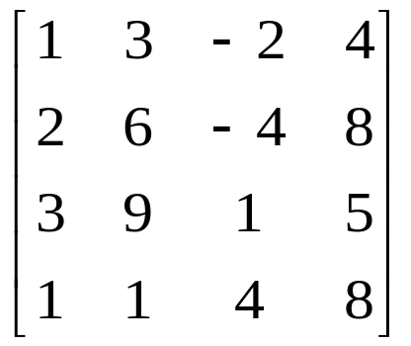
Example 5
Let T _{A}:R ⁴ -> R ⁴ be multiplication by
A=
Determine whether T _{A} is one to one.

Slide 61
Example 5(Cont.)
Solution:
det(A)=0,since the first two rows of A
are proportional and consequently A I
is not invertible.Thus, T _{A} is not one
to one.

Slide 62
Inverse Linear Transformations
If T :V -> W is a linear transformation,
denoted by R (T ),is the subspace of W
consisting of all images under T of vector
in V.
If T is one to one,then each vector w in
R(T ) is the image of a unique vector v in V.

Slide 63
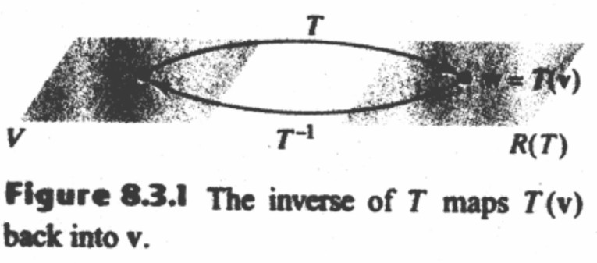
Inverse Linear Transformations
This uniqueness allows us to define a new
function,call the inverse of T. denoted
by T ^{–1}.which maps w back into v(Fig 8.3.1).

Slide 64
Inverse Linear Transformations
T ^{–1}:R (T ) -> V is a linear transformation.
Moreover,it follows from the defined of T ^{–1} that
T ^{–1}(T (v)) = T ^{–1}(w) = v (2a)
T ^{–1}(T (w)) = T ^{–1}(v) = w (2b)
so that T and T ^{–1},when applied in succession in
either the effect of one another.

Slide 65
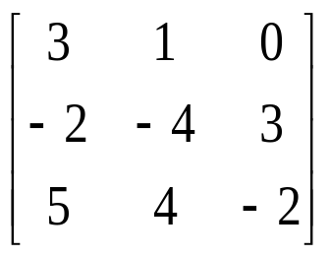
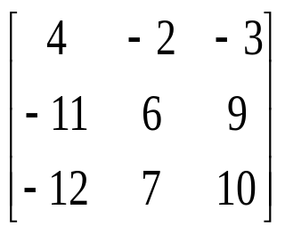
Example 7
Let T :R ³ ->R ³ be the linear operator
defined by the formula
T (x₁,x₂,x₃)=(3x₁+x₂,-2x₁-4x₂+3x₃,5x₁+4 x₂-2x₃)
Solution:
[T ]= ,then[T ]⁻¹=

Slide 66
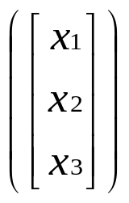
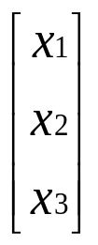
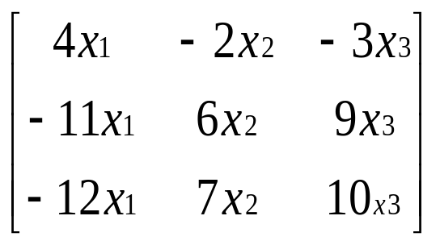
Example 7(Cont.)
T ^{–1} =[T ^{–1}] =
=
Expressing this result in horizontal notation yields
T ^{–1}(X₁,X₂,X₃)=(4X₁-2X₂-3X₃,-11X₁+6X₂+9X₃,-12X₁+7X₂+10X₃)

Slide 67
Theorem 8.3.3
If T₁:U->V and T₂:V->W are one to one linear transformation then:
(a)T₂ 0 T₁ is one to one
(b) (T₂ 0 T₁)⁻¹ ⁼ T₁⁻¹ 0 T₂⁻¹

